Slide 1
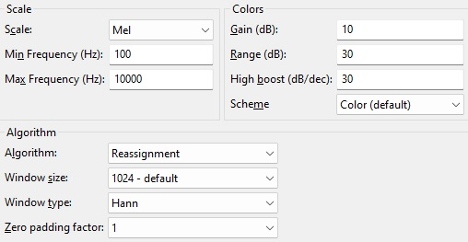
Vocal detection within musical compositions using Mel Spectrogram analysis/visualization
Audacity spectrogram visualization settings for analysis of music files
Observations:
Based upon the sample songs considered for this report the images contained on the following pages might be thought to reveal the following
two characteristics of human lead vocals within a musical composition that can be discerned on a Mel spectrogram
Vocal hiss, which appears as (primarily) short burst high frequency “blue” noise power waveforms
Vocal harmonics, which appear as multiple stacked and shifting/sliding/generally irregular/complex power waveforms (not flat or sinusoidal)

Slide 2
A technique is sought to filter and time index musical compositions based upon the Mel spectrogram structures postulated to represent lead signer vocalizations onset and offset within this report to enable the automation of song partitioning (and by extension, other audio recordings that include human voices) into a series of clips containing distinct phrases and/or complete sentences for the purpose of further analysis (including speech recognition and transcription).

Slide 3
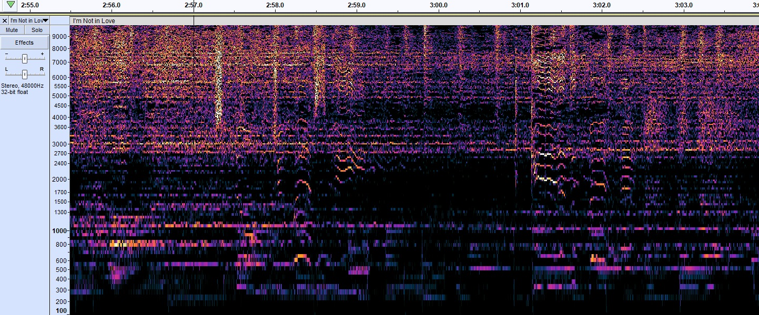

10cc - I’m not in love
stacked irregularly shaped waveforms
stacked irregularly shaped waveforms
~14 stacked irregularly shaped waveforms
“ahhhhh”
strong background vocal
{click image to listen}
“so don’t you ask me”
“ahhhhh”
soft background vocal
{click image to listen}
“give it back”
{click image to listen}

Slide 4
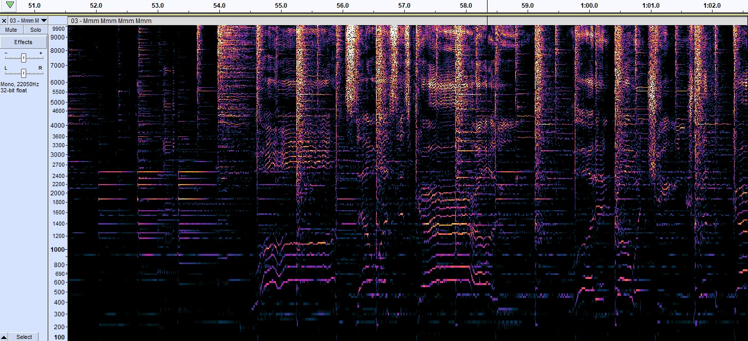
Crash Test Dummies – Mmm Mmm Mmm Mmm
vocal hiss
~6 stacked flat waveforms
~14 stacked irregularly shaped waveforms
[guitar]
{click image to listen}
“once there was a girl who”
{click image to listen}
“wouldn’t go and change with the girls in”

Slide 5
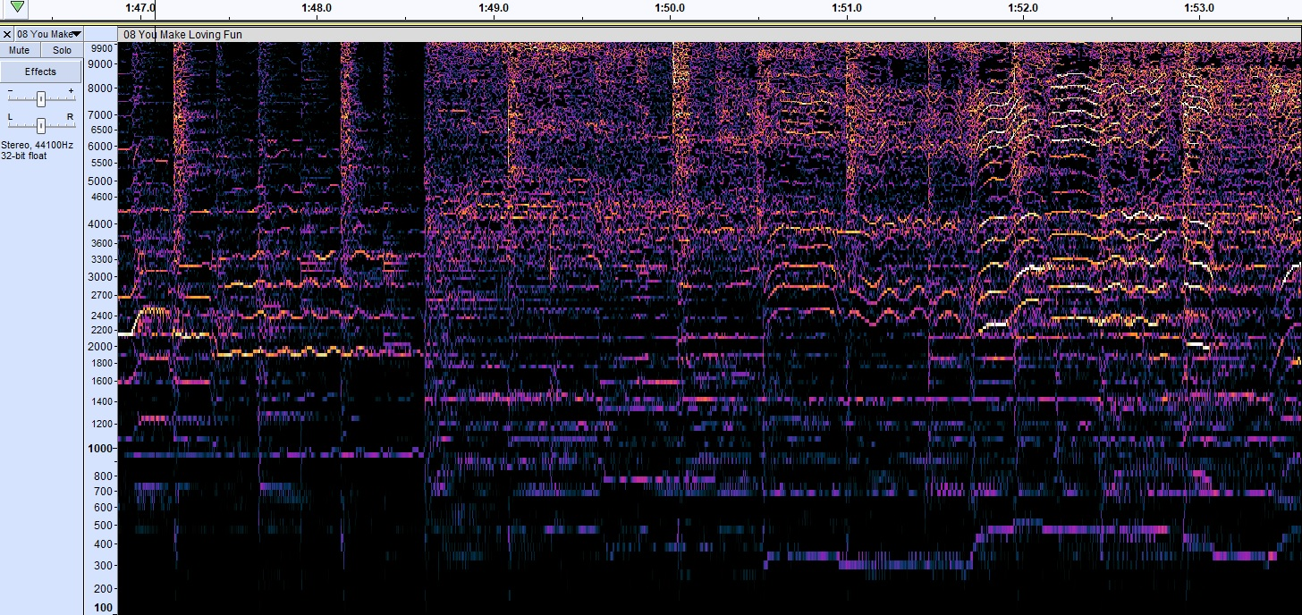
Fleetwood Mac – You make loving fun
~6 stacked sinusoidal waveforms
numerous stacked irregularly shaped waveforms
~14 stacked irregularly shaped waveforms
[guitar]
{click image to listen}
“ahhhhh”
soft background vocal
{click image to listen}
“you believe”
{click image to listen}

Slide 6
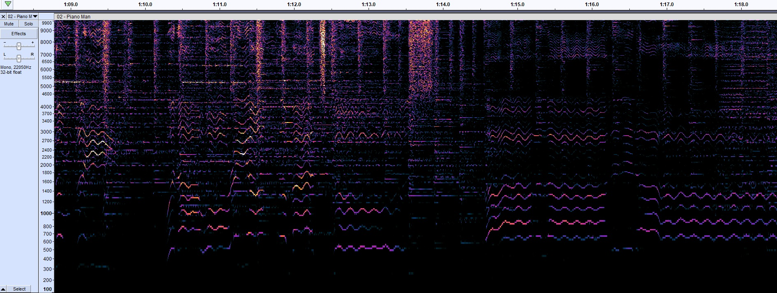
Billy Joel – Piano Man
~14 stacked irregularly shaped waveforms
~14 stacked irregularly shaped waveforms
[piano]
{click image to listen}
“when I wore a younger man’s clothes”
{click image to listen}
“lah la la ditty dah”
{click image to listen}

